Slide 1



HERO – Saving Teams from Danger
Jonah Soos, Payton Smith, Owen St.Onge, Andrew Diamond, and Jacob Kalamvokis
Notes:
Jonah

Slide 2
Introduction
Reliever performance is challenging to quantify
Existing stats generally fail to account for game situation, opposing batter strength, etc
All in all, they do not effectively reflect pitcher success
WAR
Saves
Blown Saves
?
Shutdowns
Meltdowns
ERA
FIP
WHIP
Notes:
Payton

Slide 3
Introduction
Saves
Entered the game with a lead of no more than three runs and pitched at least one inning
Pitched at least three innings and finished the game
Entered the game with the tying run in the on-deck circle, at the plate or on the bases
Arbitrary qualifications – not statistically backed and is extremely subjective
Notes:
Payton

Slide 4





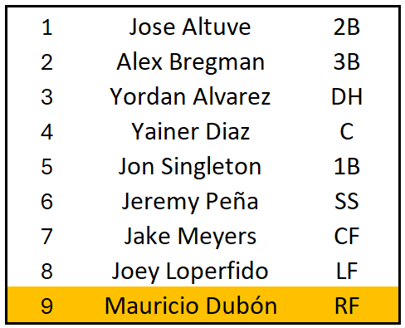
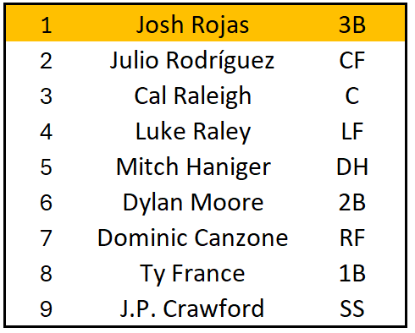
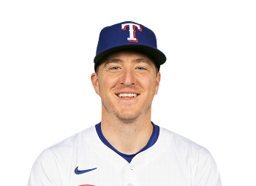
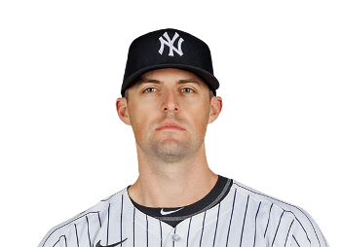
Inefficiencies in Saves
Non-Save Situation
Save Situation
2
1
4
1
Josh Sborz
Clay Holmes
5th Inning
0 Outs
9th Inning
0 Outs
Who should be rewarded?
Notes:
Payton

Slide 5
Methodology
Goal: Reward relievers for the challenge they face and ability to overcome
Threat:
What threat does the situation pose?
Pressure:
What kind of pressure is on the pitcher?
Danger
Ability to Overcome
Outcome
Challenge
ΔWP
Danger
HERO
Notes:
Jonah

Slide 6
What Makes an Appearance a Challenge?
Pressure
2
1
Josh Sborz
Inning
Score Difference
Threat
Opposing Batters
Base State
5th Inning
0 Outs
Game State
Momentum
Notes:
jacob
Talk about the differences between Sborz situation and Holmes situation, what differentiates the two?
Overall, which appearance has a higher level of "difficulty" and why? (This is our Danger)
Each can be talked about in context, but should be able to relate back to something we accounted for (momentum, threat, pressure, etc.)

Slide 7
Quantifying Momentum
Momentum: Not something you can see, but something you can feel
Runs
Hits
Evaluate at bats after runs score
Question:
Evaluate at bats after hits
Holding all else constant, is there a quantifiable residual scoring effect in baseball?
Notes:
jacob
Transition into momentum, explain relevance of momentum in baseball terms:
"Not something you can see, but something you can feel"
This slide should serve to show that we're just trying to combine baseball intuition and stat knowledge to see if anything is actually there
Just talk about the concept of momentum here and share results later

Slide 8
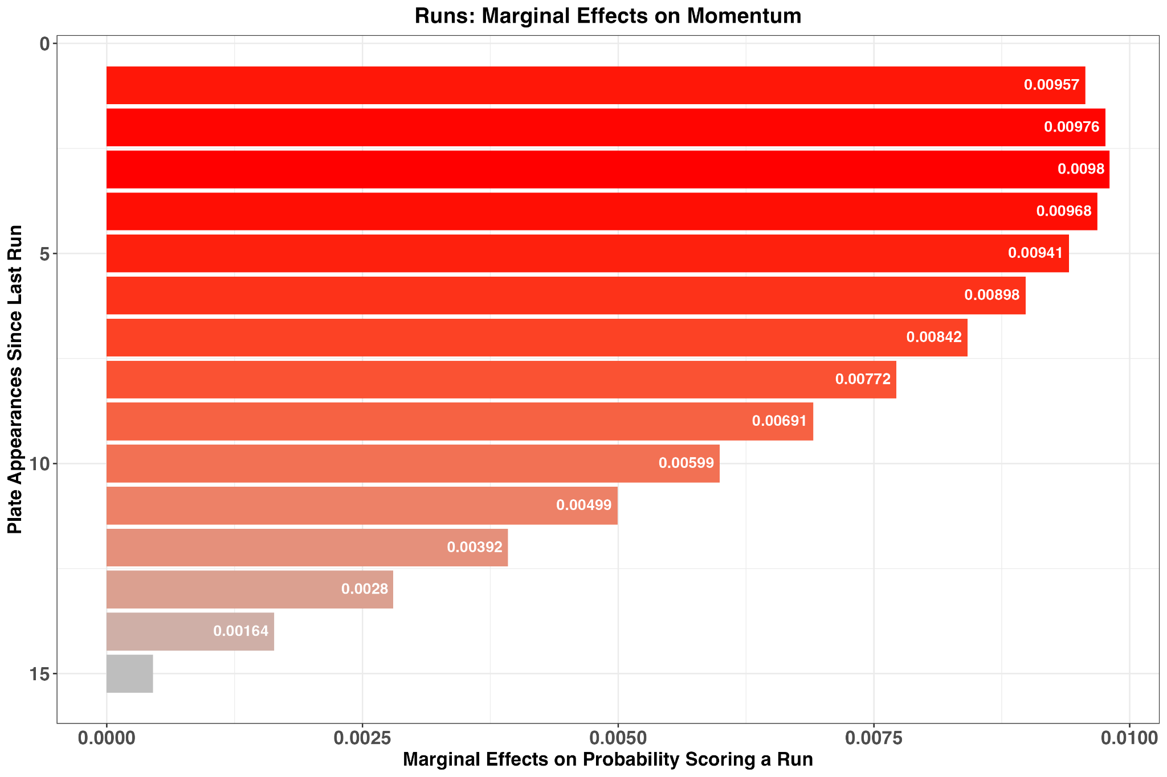
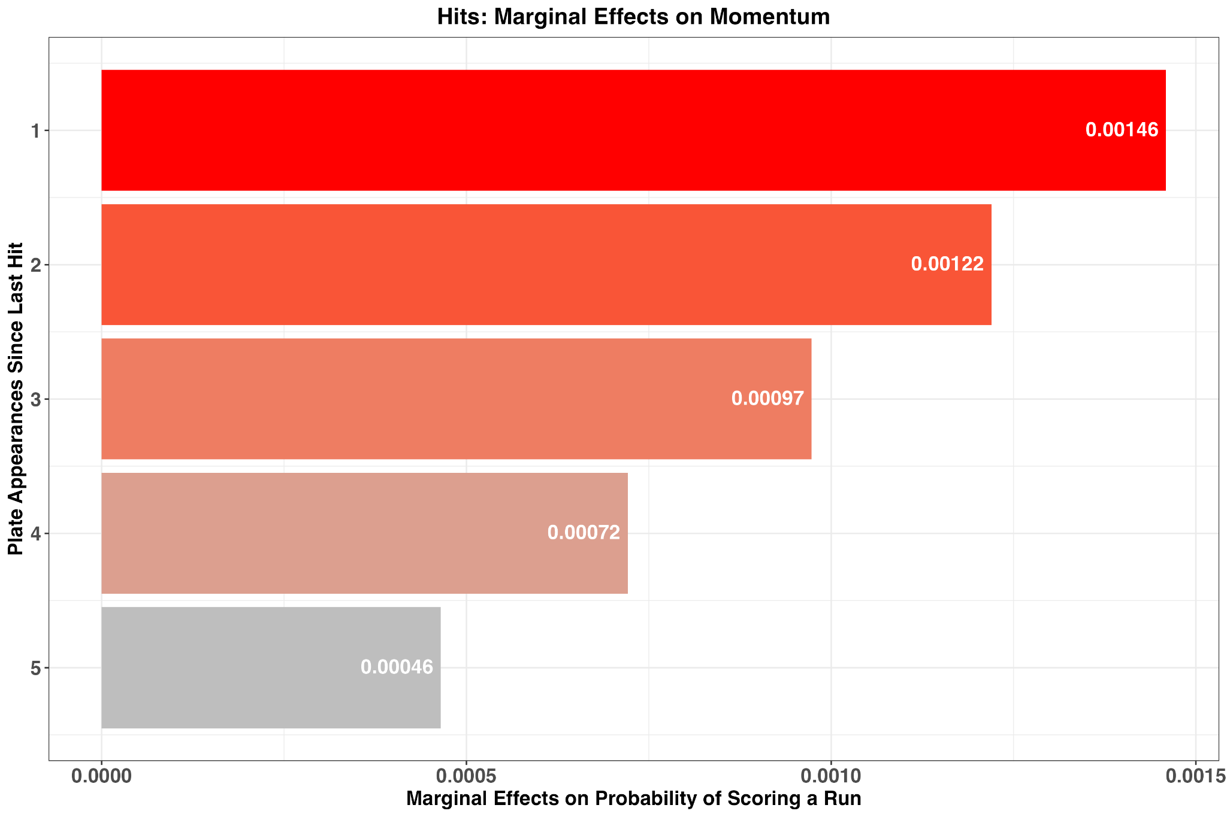
Momentum Marginal Effects
Logit: Holding game state, team quality, batter quality, and runs scored constant, is there quantifiable residual scoring effect (momentum)?
Runs
Hits
Notes:
jacob
Talk about our logit, what went in, what came out
Overall, marginal effects are real and they're statistically significant, although they're not super impactful
Definitely mention how they "wear off" over time, and how this changes for runs/hits

Slide 9
How Does Momentum Fit?
Momentum
Threat:
What threat does the situation pose?
Pressure:
What kind of pressure is on the pitcher?
Danger
Ability to Overcome
Outcome
Challenge
ΔWP
Danger
HERO
Notes:
jonah

Slide 10
Quantifying Threat
Threat: Inning and Score independent expected outcome model
Threat
Opposing Batters
Base State
2
1
Josh Sborz
Game State
Momentum
Park Effects
Handedness
5th Inning
0 Outs
Classification XGBoost – Probability of Scoring Runs
Notes:
jonah

Slide 11
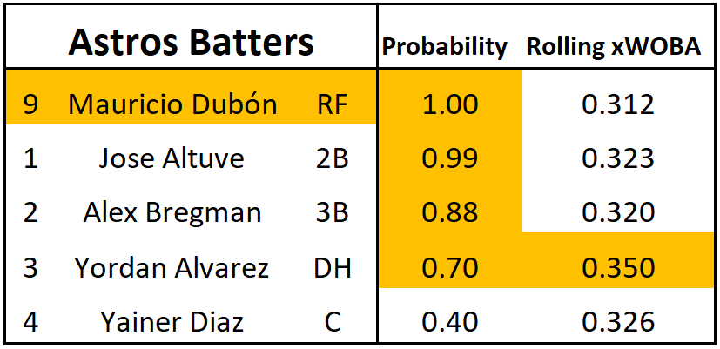
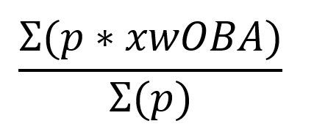
Quantifying Batter Threat
Batter Skill: xwOBA
Rolling Mean of last 375 PAs for each batter due up (stable)
Calculated likelihood of how many more batters the pitcher will see for the rest of the inning
Historical data (using outs and base state) to derive probability
Independent of pitcher effects
5th Inning
0 Outs
Batter Skill = = 0.325
Notes:
jonah

Slide 12
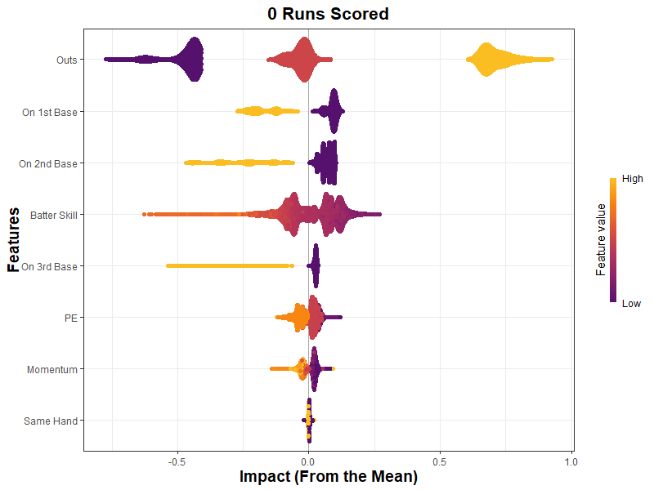
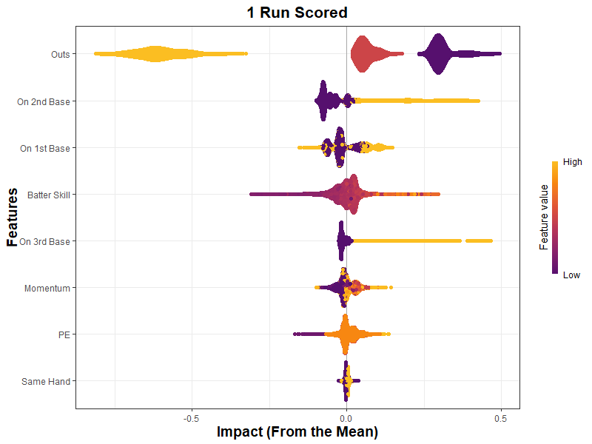
Threat Predicted Values
Threat Validation: Intuitive baseball relationships hold
2 Outs
Probability
Probability
Probability
Probability
Notes:
jonah

Slide 13
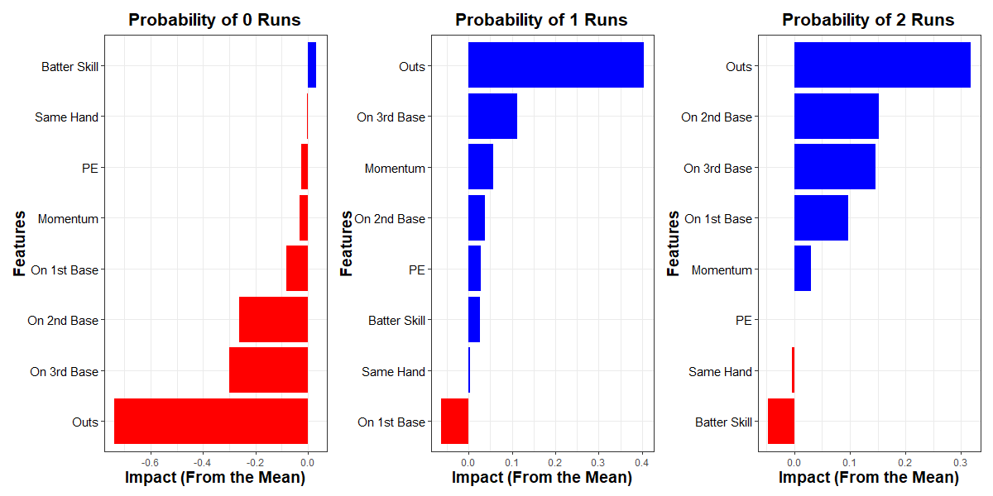
Josh Sborz Predictions
Predictions: 33% Chance 27% Chance 16% Chance
Notes:
jonah

Slide 14
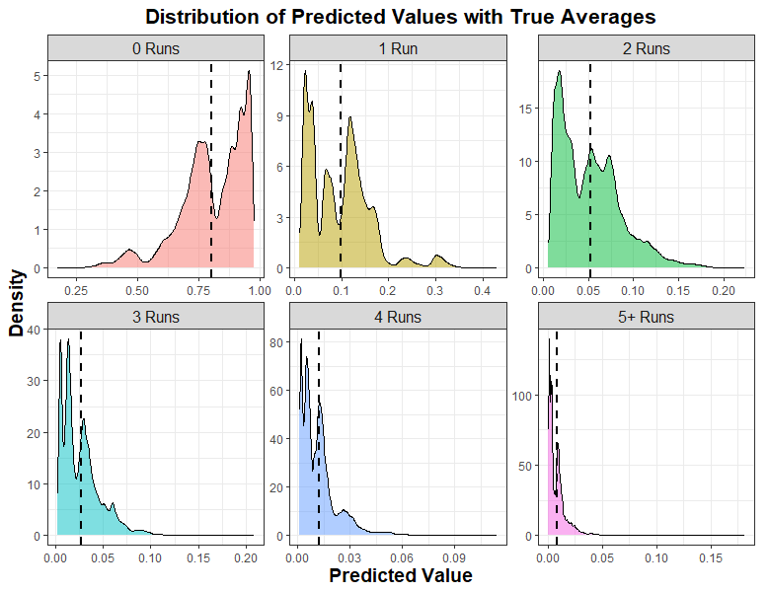
Threat Predictions vs Actuality
Slightly over predicting 0 runs
Under predicting scarce event (3-5 runs)
Harsh on pitchers when comparing actuality
Improved with further model tuning
Notes:
jonah

Slide 15
From Threat to Pressure
Threat
Probability of Allowing 0:5 Runs
Expected Runs
Pressure:
What kind of pressure is on the pitcher?
Danger
Ability to Overcome
Outcome
Challenge
ΔWP
Danger
HERO
Notes:
Stonge Jonah talked about threat – difficulty of situtation taking into account batter effects, men on base, outs and momentum. However, another key aspect of a relief appearance is the magnitude that the situation impacts the game, which we defined as pressure

Slide 16
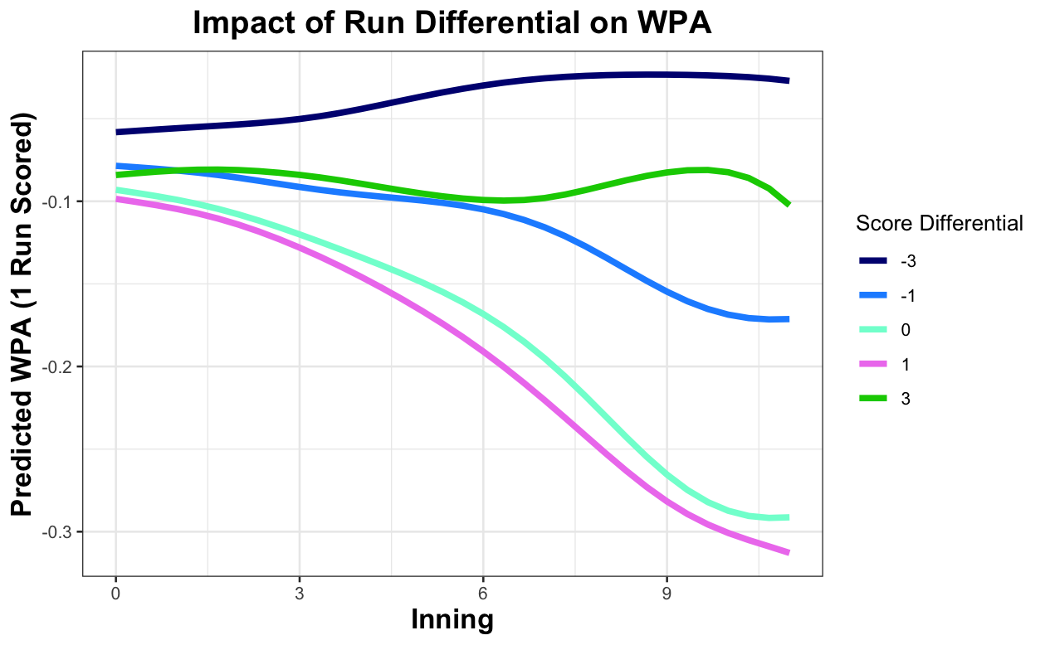
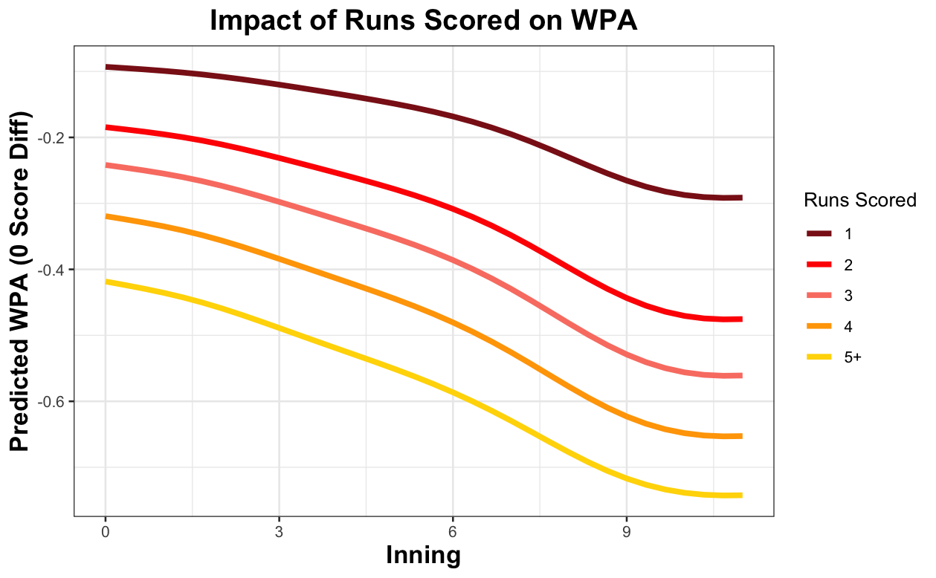
Pressure
GAM: Holding all else constant, how does score differential and number of runs scored impact WPA?
What is the Value of a run?
Impact of scoring 0 runs on a play modeled separately for negative and positive events
Notes:
Stonge: We creatred a general additive model to determine the effects of score differential and the number of runs scored on WPA – essentially to determine the value of a run in a given situation a pitcher may find themselves in. This graph on the left holds all situation effects constant – base state and batter effects, the things from the threat model – and displays the impact of scoring 1 run for each score differential throughout the game. The important thing to note here is that pitching appearances in close games, especially when tied or up by one, are the highest pressure spots. The graph on the right is the same concept, however instead holds constant score differential at a tie game and visualizes the impact of runs scored. One run scored in the first inning is worth less than 10% WPA while a grand slam in the night is worth over 70% WPA. Also to note – the impact of scoring 0 runs on a play was modeled separately for negative and positive events

Slide 17
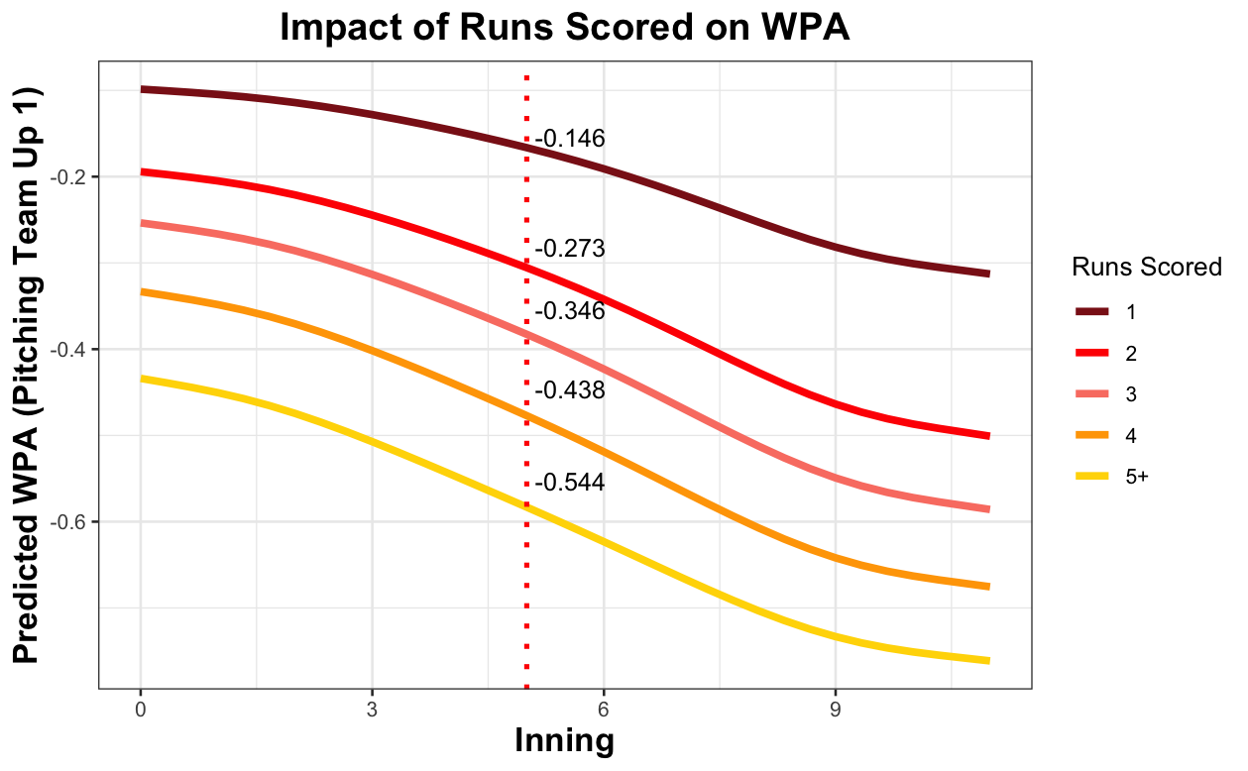
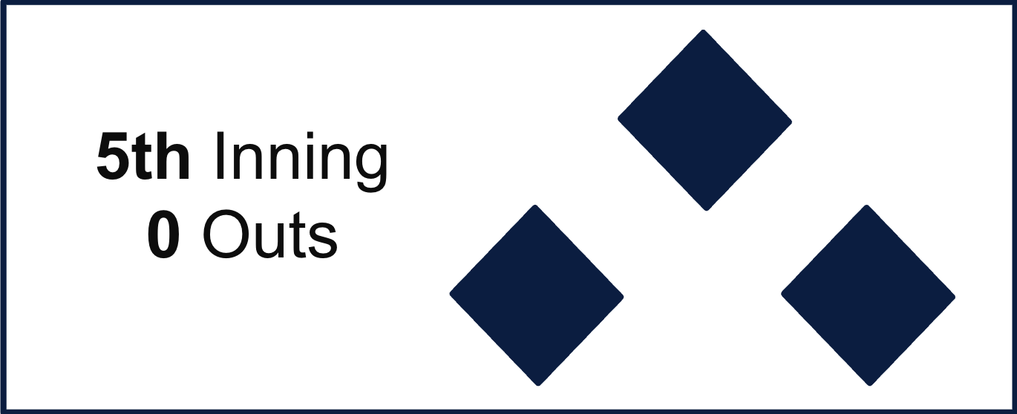
Pressure
What is the Pressure on Sborz here?
2
1
Josh Sborz
Pressure avoided = % of Win Retained
Notes:
Stonge To better understand this, lets take a look at the Josh Sborz example from before. He came in up 1 run with 0 outs in the fifth, represented by the red dotted line in the graph, and next to each line interestection the WPA values for each runs scored are printed. If sporz allowed one run, he wouldve given up 14.6 WP and if he allowed 5+ runs he wouldve given up 54.4 WP, a very high pressure situation. The pressure sborz is able to avoid is essentially hte % of the win sborz retains for his team in his appearance.

Slide 18
Introducing Danger
Threat
Pressure
Probability of Allowing 0:5 Runs
Expected Runs
Value of allowing 0:5 Runs
WP Value
Danger
Ability to Overcome
Outcome
Challenge
ΔWP
Danger
HERO
Notes:
Jonah

Slide 19
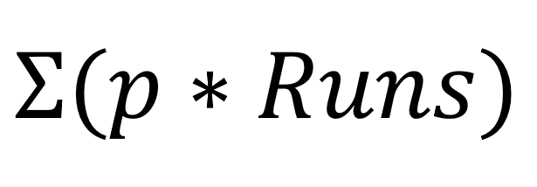
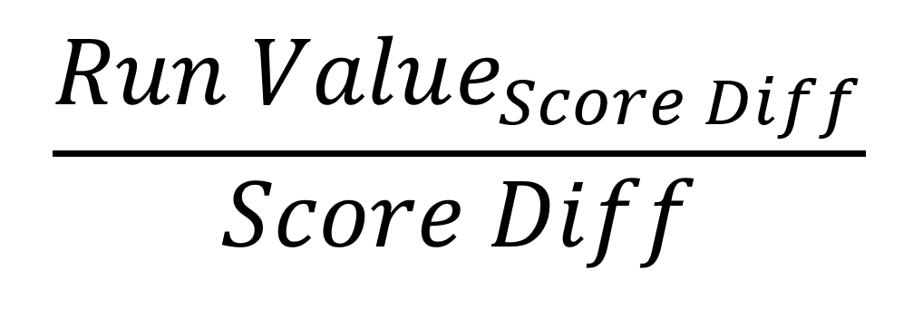
Danger Calculation
Threat: Probability of Allowing Runs
Pressure:
Win Probability Value of Runs
Danger:
Expected Win Probability Added
0 Runs: 0.325
1 Run: 0.269
2 Runs: 0.163
3 Runs: 0.103
4 Runs: 0.071
5+ Runs: 0.069
0 Runs: 0.005
1 Run: -0.146
2 Runs: -0.273
3 Runs: -0.346
4 Runs: -0.438
5+ Runs: -0.544
-0.186
Expected to lose 18.6% Win Probability.
Danger+ = 153
Threat+: 143
Pressure+: 110
Notes:
Jonah
Bring back in our overall methodology image, and be sure to outline the
"threat x pressure = danger" part of it
Ultimately, the DANGER metric serves as a way to estimate deltaWP for the rest of any given inning
Might be useful to go through an example of how threat and pressure come together to get danger (kind of similar to what we did on the whiteboard)
Also might be helpful/validating to show a DANGER distribution?
Mostly negative values, since allowing a run has a more negative result than preventing a run has a positive result

Slide 20
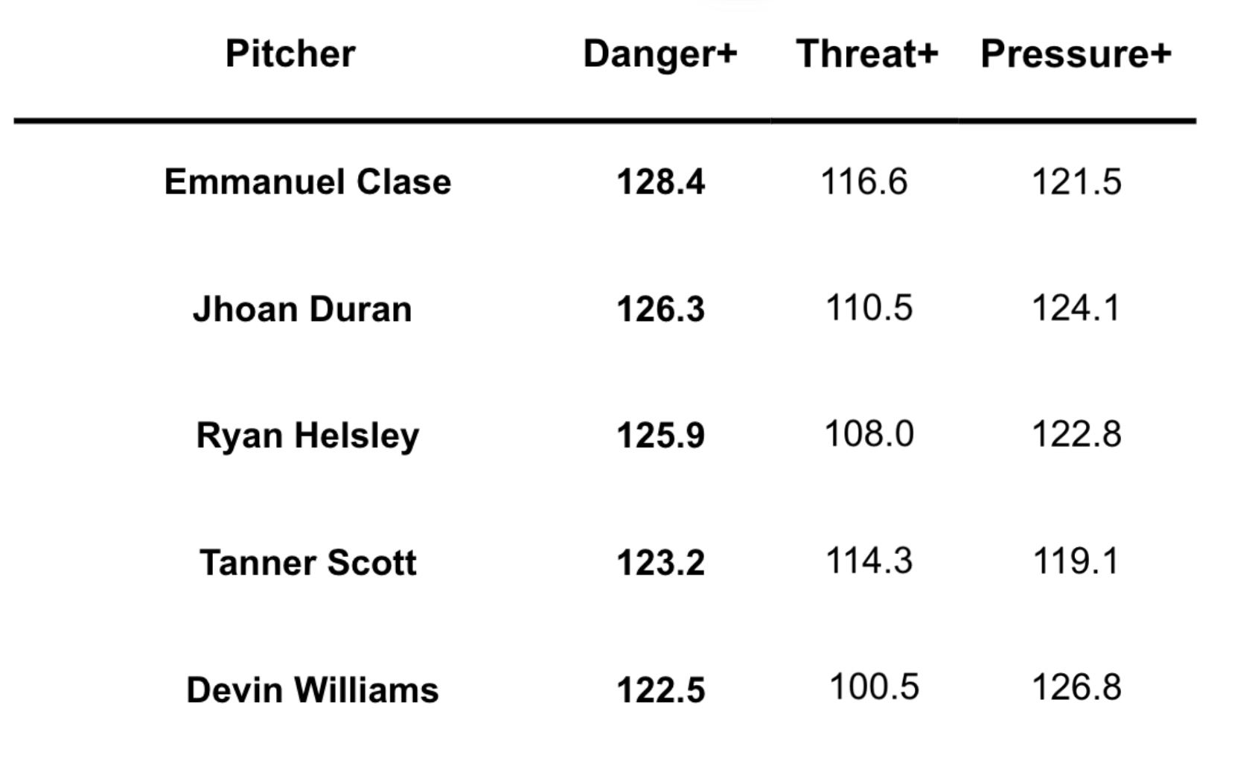
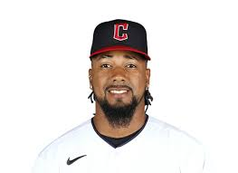
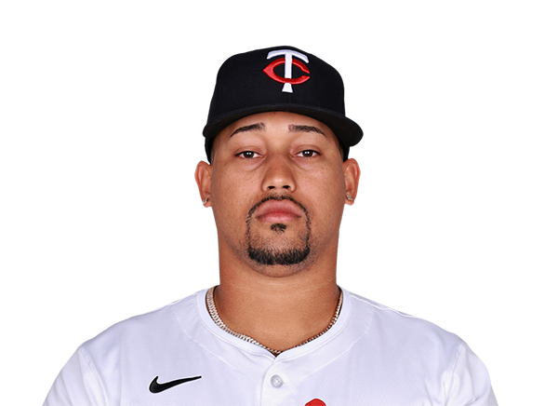
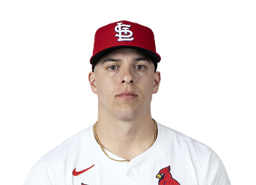

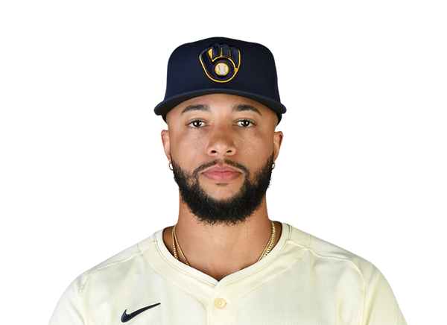
Danger Leaderboard 2024
Pitcher | Danger+
Emmanuel Clase | 128.4
Jhoan Duran | 126.3
Ryan Helsley | 125.9
Tanner Scott | 123.2
Devin Williams | 122.5
Threat+ | Pressure+
116.6 | 121.5
110.5 | 124.1
108.0 | 122.8
114.3 | 119.1
100.5 | 126.8
Notes:
Andrew
Bring back in our overall methodology image, and be sure to outline the
"threat x pressure = danger" part of it
Ultimately, the DANGER metric serves as a way to estimate deltaWP for the rest of any given inning
Might be useful to go through an example of how threat and pressure come together to get danger (kind of similar to what we did on the whiteboard)
Also might be helpful/validating to show a DANGER distribution?
Mostly negative values, since allowing a run has a more negative result than preventing a run has a positive result

Slide 21

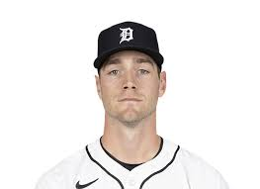
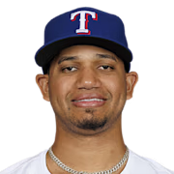
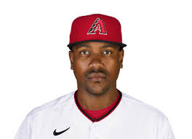
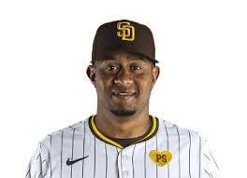

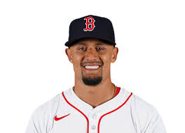
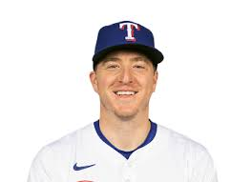
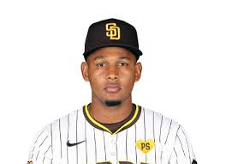
Pitcher Interdependence
Leave their team in more danger
Create more danger during appearance
Pitcher | Final Danger+
Brenan Hanifee | 65.15
Gerson Garabito | 70.01
Wandy Peralta | 70.31
Brennan Bernardino | 74.13
Josh Sborz | 74.36
Pitcher | Net Danger+
Joey Wentz | 77.55
Thyago Vieira | 78.42
Josh Fleming | 78.47
Gerson Garabito | 80.24
Jhony Brito | 80.83
Notes:
Andrew explain what these stats mean,
Andrew
Worst Danger Final & Worst Net Danger Leaderboards – Who fucks over their bullpen
"threat x pressure = danger" part of it
Ultimately, the DANGER metric serves as a way to estimate deltaWP for the rest of any given inning
Might be useful to go through an example of how threat and pressure come together to get danger (kind of similar to what we did on the whiteboard)
Also might be helpful/validating to show a DANGER distribution?
Mostly negative values, since allowing a run has a more negative result than preventing a run has a positive result

Slide 22
The Final Piece — HERO
Threat
Pressure
Danger
Expected
Performance
Actual
ΔWP
Danger
HERO
Notes:
Jacob

Slide 23
HERO Calculation
HERO – How well do you save your team from danger?
∑( )_{inning}
Δ Win% Danger
Essentially, HERO tells us value over expected.
Notes:
Jacob

Slide 24
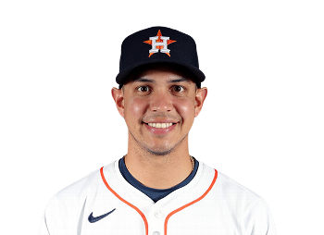
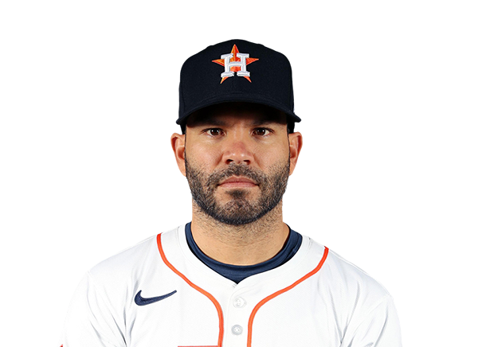
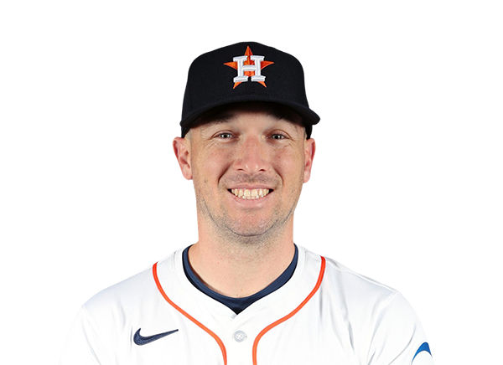
HERO Explained
Danger: - 0.186 Δ Win Probability
WP_{Enter} = 0.348
2
1
Batter | Outcome | Runs Scored
Mauricio Dubon | Strikeout | 0
Jose Altuve | Popup | 0
Alex Bregman | Groundout | 0
Josh Sborz
WP_{End} = 0.667
5th Inning
0 Outs
Actuality: + 0.319 Δ Win Probability
Notes:
Jacob
WPenter?
Introduce our stat
Definitely include our main equation, which pretty much is just expected deltaWP - actual
Be sure to talk about how this value is accumulated inning by inning, and the sum of all innings in a game is their outing HERO
Provides a sense of value over expected

Slide 25
The Final Piece – HERO
Danger
HERO
Actual
+0.319
-0.186
0.505
Essentially, Josh Sborz performance gave his team a 50.5% Boost in Win Probability when compared to how Danger expected him to perform, equating to 0.505 Wins.
Notes:
Jacob

Slide 26
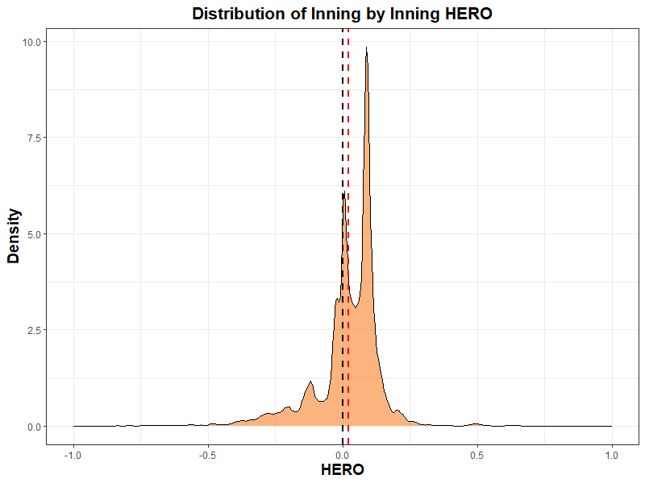
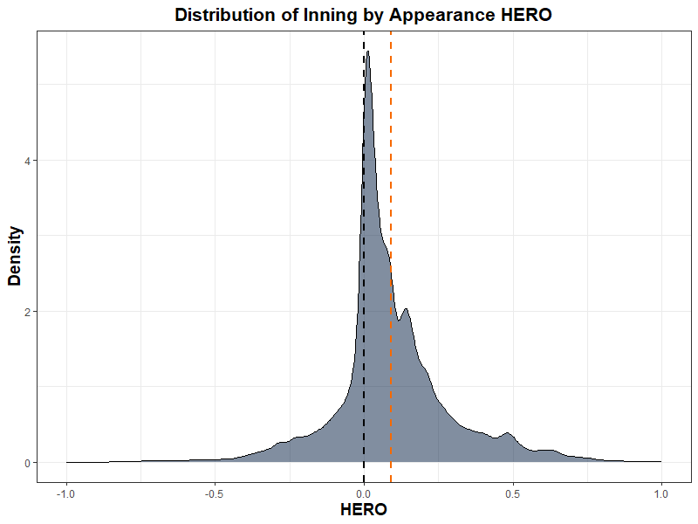
HERO Distribution
Hero is generally positive for pitchers: relief pitchers are expected to be able to consistently get outs, and for the most part, they do.
Right shifted mean
Notes:
Andrew
Talk about any and all assumptions here (and why most of them don't really matter)
Punishes you more if you don't get out of the inning
Not a huge concern with the 3-batter minimum, "too bad",
Isnt this a good thing
Outcome based, does not account for fielding skill or errors (favors K pitchers)
Essentially, it's an outcome-based league: strike him out next time
Just like saves, our stat is explanatory, which is fine.

Slide 27
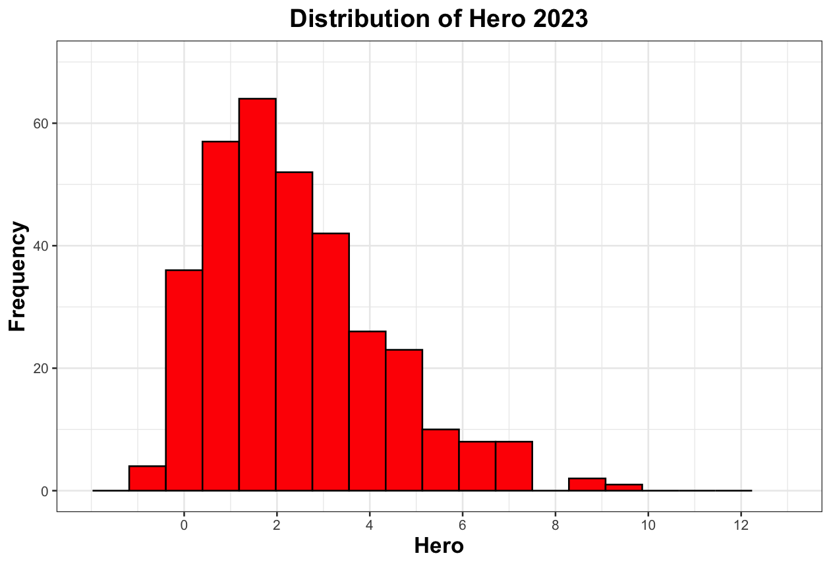
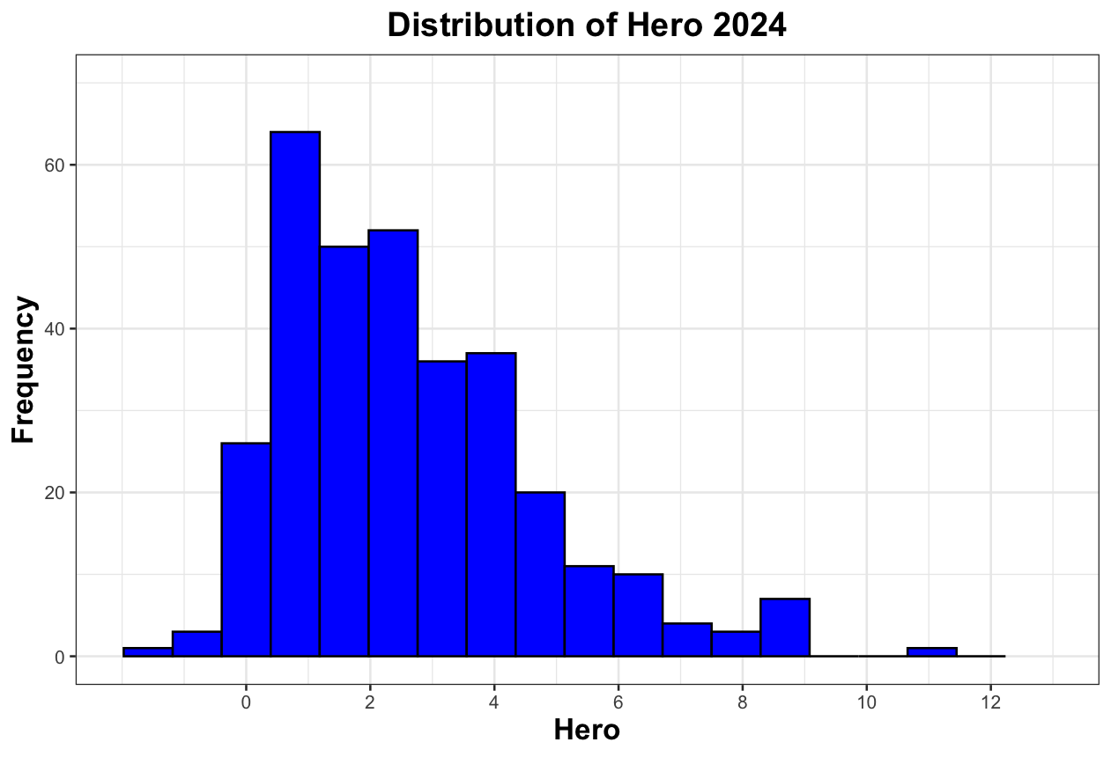
HERO Distribution
Only the best pitchers will have the ability to get the job done in high Danger and Pressure spots, earning them the highest HERO Scores
All relief pitchers faced less than 15 batters on average and made 15+ appearances
Notes:
Andrew
Might be helpful to include a distribution of the raw stat? Talk about how most pitchers have positive values since they are supposed to be good at their jobs, and only the best pitchers will have the ability to pitch in high leverage scenarios which will earn them a higher HERO score
For qualifying stats (how many appearances are required), talk about those here as well

Slide 28

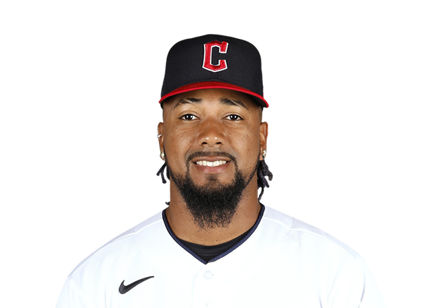
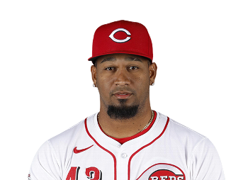
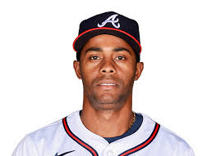
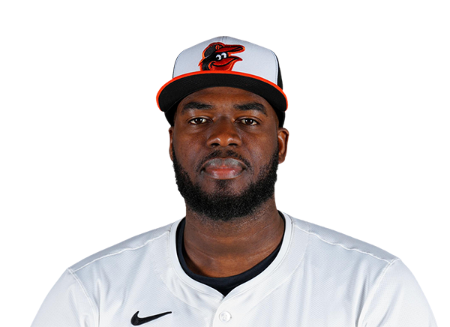
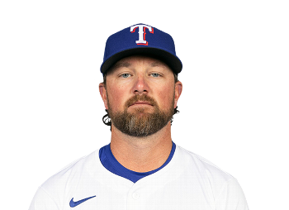
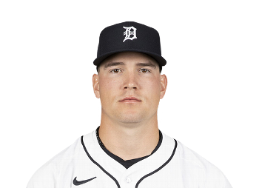
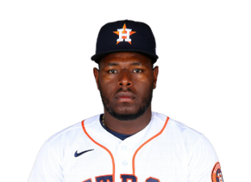
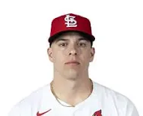
HERO: Cumulative Leaderboard
2023
2024
Pitcher | Hero | Hero+
Tanner Scott | 9.69 | 139.00
Alexis Díaz | 8.79 | 134.19
Félix Bautista | 8.54 | 132.84
Devin Williams | 7.50 | 127.31
Hector Neris | 7.31 | 126.32
Pitcher | Hero | Hero+
Emmanuel Clase | 11.13 | 141.77
Raisel Iglesias | 8.58 | 129.24
Kirby Yates | 8.51 | 128.89
Tyler Holton | 8.49 | 128.83
Ryan Helsley | 8.48 | 128.77
Notes:
Andrew

Slide 29
Converting HERO to Saves
Saves: an incredibly flawed statistic meant to measure how closing pitchers deliver their teams wins
Problems With Saves:
Potential Fixes:
Very specific qualifications, may not be highest leverage spot
Make qualifications flexible, take leverage into account
All saves are created equal
Evaluate the difficulty of each situation accordingly
Better team offenses create more opportunity
Account for score differential, use a rate stat
Transition slide: converting HERO to some sort of Save Statistic
Save = preserving a win
But who says this has to happen in the 9th?
Notes:
Stonge – So, we have our hero stat for all relievers, but we still need to redefine saves. Saves are an incredibly flawed statistic meant to measure how closing pitchers deliver their teams wins. There are inherent problems with this statistic, but there are also hypothetical fixes.

Slide 30

The HERO Save
Introducing: Hero Saves
Our Hero Statistic in appearances when the pitching team is winning
Make qualifications flexible, take leverage into account
Game leverage accounted for in Threat and Pressure, no longer bound by 9th+ innings
Evaluate the difficulty of each situation accordingly
Danger stat used to encompass situation difficulty
Account for score differential, use a rate stat
Score differential accounted for in Pressure, rate stat created
Notes:
Stonge – Our HERO stat actually accounts for most of these problems very well, and can easily be converted to looking only at appearances when the pitching team is winning in order to isolate sports where relievers preserve leads.

Slide 31
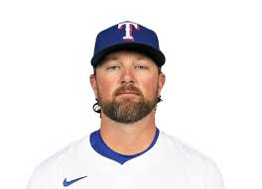
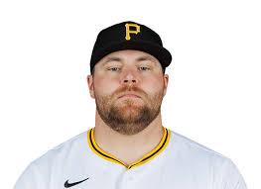
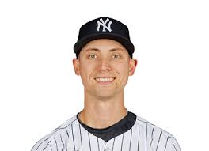
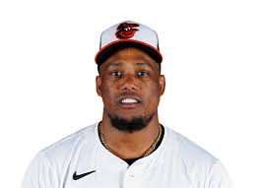
HERO Save: Leaderboard
HERO: Save Leaderboard
2023
2024
Pitcher | Hero Save | Hero Save+
Tanner Scott | 6.64 | 140.06
Alexis Díaz | 6.44 | 138.59
Félix Bautista | 6.32 | 137.69
David Bednar | 5.49 | 131.58
Yennier Cano | 5.17 | 129.42
Pitcher | Hero Save | Hero Save+
Emmanuel Clase | 8.12 | 147.72
Ryan Helsley | 7.30 | 141.98
Kirby Yates | 6.45 | 135.97
Luke Weaver | 5.76 | 131.14
Raisel Iglesias | 5.37 | 128.41
Notes:
Payton

Slide 32

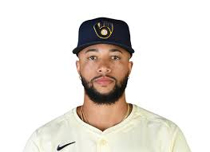




HERO: Rate Leaderboard
HERO Saves: Rate Leaderboard
2023 (min. 15 appearances with lead)
2024 (min. 15 appearances with lead)
Pitcher | Hero Win Rate
Alexis Díaz | 0.1239
Félix Bautista | 0.1171
Tanner Scott | 0.1145
Chris Martin | 0.1123
Joel Payamps | 0.1122
Pitcher | Hero Win Rate
Devin Williams | 0.1414
Emmanuel Clase | 0.1377
Kirby Yates | 0.1371
Ryan Helsley | 0.1259
Edwin Uceta | 0.1205
Notes:
Payton - note that this is possible because our stat is not a counting stat and failures negate from the stat rather than going into a fully different category (blown saves)

Slide 33


Overvalued, Undervalued…
Comparing saves leaders to their ranking in hero saves
Notes:
Payton

Slide 34
Redefining Closers
By our metrics, true closers should see a mix of Threat and Pressure
High Threat
Relievers
(>100, 110+)
Extinguisher (110+, 110+)
Enter any situation and dominate
Closer
(110+, >100)
Low Threat
Low Pressure
High Pressure
Notes:
Stonge – Now that we’ve redefined saves, we also need to redefine the way we look at the closer role. In reality, closers are pitchers who enter almost exclusively into ninth inning save situations, high threat regarless of pressure, but we believe true closers should enter games in the most dangerous spots: the highest mix of threat and pressure. We are defining these pitchers as extinguishers, and you can see them on the top right of this threat by pressure grid. These are guys who can nter any situation and dominate

Slide 35










Top 5 Each Role, 2024
Extinguishers
Closers
Relievers
Pitcher | Hero+
E. Clase | 141.78
T. Scott | 126.76
J. Adam | 122.54
G. Jax | 119.59
J. Duran | 115.21
Pitcher | Hero Save+
K. Yates | 141.77
R. Walker | 129.24
A. Munoz | 128.77
A. Kittredge | 127.94
J. Hader | 126.75
Pitcher | Non-SaveHero+
J. Koenig | 128.55
R. Iglesias | 120.28
N. Martinez | 120.12
M. Miller | 119.70
T. Holton | 119.46
Notes:
Stonge

Slide 36
Remember Us?
2
1
4
1
Josh Sborz
Clay Holmes
9th Inning
0 Outs
5th Inning
0 Outs
As seen previously, he shut the door.
HERO = +0.505
Mr. Holmes was not as fortunate…
HERO = WELL…
Notes:
Jacob

Slide 37








A Tale of Two Relievers…
Danger: – 0.04 Δ Win Probability
Batter | Outcome | Runs Scored
Josh Rojas | Groundout | 0
Julio Rodriguez | Single | 0
Cal Raleigh | Walk | 0
Luke Raley | Single | 1
Mitch Haniger | Single | 2
Dylan Moore | Walk | 2
Dominic Canzone | Sac Fly | 3
Ty France | Single | 4
4
1
Clay Holmes
9th Inning
0 Outs
YANKED.
HERO = – 0.765
Notes:
Jacob - mention how Caleb Ferguson came in after, got the out Holmes couldn't, was rewarded with a 110 HERO+

Slide 38






A Tale of Two Relievers…
Danger: – 0.108 Δ Win Probability
Batter | Outcome | Runs Scored
Anthony Volpe | Strikeout | 0
Juan Soto | Single | 0
Aaron Judge | Strikeout | 0
Alex Verdugo | Groundout | 0
4
5
Andrés Muñoz
Shuts the door, gets the win.
Actual ΔWP: + 0.194
HERO = + 0.302
9th Inning
0 Outs
Muñoz did the job Holmes couldn't…
And that made all the difference.
Notes:
Jacob

Slide 39
Conclusion
How We Found Our HERO:
Identified meaningful situations based on the likelihood a team would score and impact on game
Made a metric (Danger) which can compare the challenge of any given situation a pitcher enters into
Acknowledges the abstract concept of momentum within a game
Our HERO's Superpower:
Evaluates pitchers based on value added by comparing expectations to reality
Completely pitcher-agnostic, not influenced by a pitcher's specific abilities
Can be applied to any relief pitcher's appearance
Notes:
Jonah

Slide 40
Questions?
Notes:
Jonah

Slide 41

Things They Might Ask About
Shiny App
https://adiamond17.shinyapps.io/HERO/

Slide 42

xwOBA Stabilization

Slide 43


Momentum Marginal Effects
Logit Model to capture probabilistic effects of each variable
Significant Predictors held constant:
Outs
Runners on Base
Score Differential
Batter & Pitcher Quality
Runs in Inning
Hits in Inning
Marginal Effects were converted back from log odds to probabilities

Slide 44

Pressure Model for Scoring Plays
GAM model to capture the effects of outs, score differential and runs scored on WPA
Predictors held constant:
Outs in inning
Runners on Base
Batter & Pitcher Quality
Holding those constant, effect of outs, score differential, runs scored and were used to determine the magnitude of pressure for each situation

Slide 45
Pressure Model for Scoring Plays
GAM model to capture the effects of outs, score differential and runs scored on WPA
Predictors held constant:
Outs in inning
Runners on Base
Batter & Pitcher Quality
Holding those constant, effect of outs, score differential, runs scored and were used to determine the magnitude of pressure for each situation

Slide 46


Pressure Model for Non-Scoring Plays
Non-Scoring Positive
Non-Scoring Negative
GAM models to capture the effects of outs and runs scored on WPA for non-scoring plays
Outs, runners on base, batter and pitcher effects held constant
Weighted mean of results with weights derived from base state used to determine WPA value for a non-scoring play for each observation

Slide 47

Threat Predictions (2-5)

Slide 48

Relief Pitcher Definition

Slide 49




Year to Year
R = .14
R = .22
R = .52
R = .47

